Slide 1

SMART INDIA HACKATHON 2026
TITLE PAGE
Problem Statement ID – 26231
Problem Statement Title – Digital Companion for Field Drug Testing
Theme – MedTech / BioTech / HealthTech
PS Category – Software
Team ID –121993
Team Name- HYPERNOVA

Slide 2
Digital Companion for Field Drug Testing
HYPER NOVA
Problem Statement
Innovation Solution
• Subjective visual interpretation: colour-change results can vary between officers.
• Incomplete digital traceability: field records may lack consistent time, location and operator details.
• Record management: paper-based or unstructured records can be difficult to retrieve and review.
• Practical need: a simple digital companion should work alongside existing colour-based field-test kits.
• Camera-assisted capture: photograph the test result with the reference colour card in-frame.
• Capture validation: check the image/workflow before saving a record.
• Safe result handling: the current prototype records an Inconclusive/manual-review outcome when validated classification is unavailable; it does not independently identify drugs.
• Integrity record: store available timestamp, GPS and operator details with a SHA-256 image hash.
• Field log: retain searchable test history, with local storage and cloud-sync workflow.
• Scope: results are presumptive and do not replace laboratory confirmation.

Slide 3
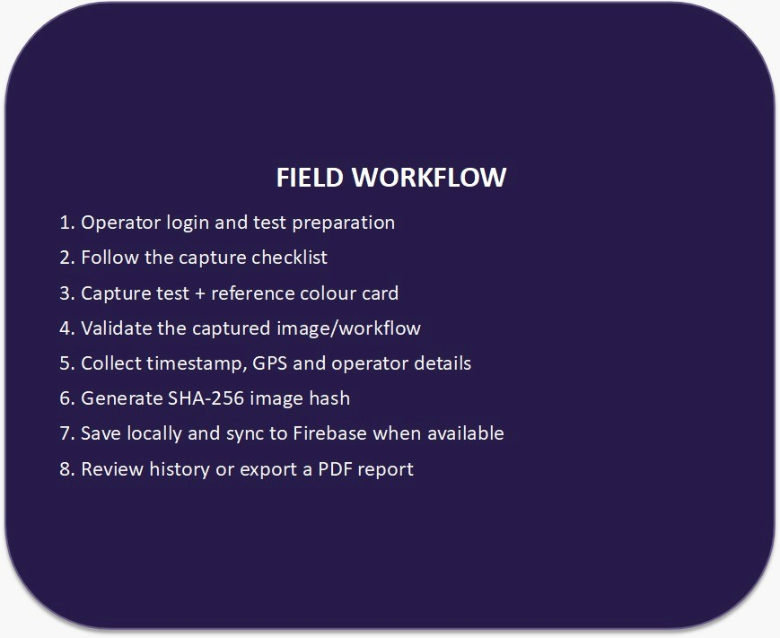
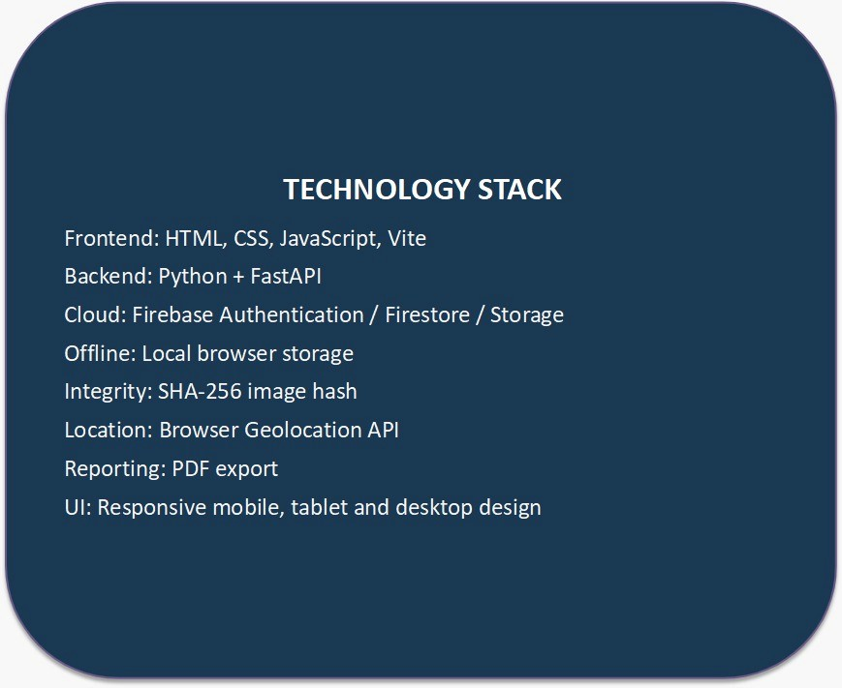
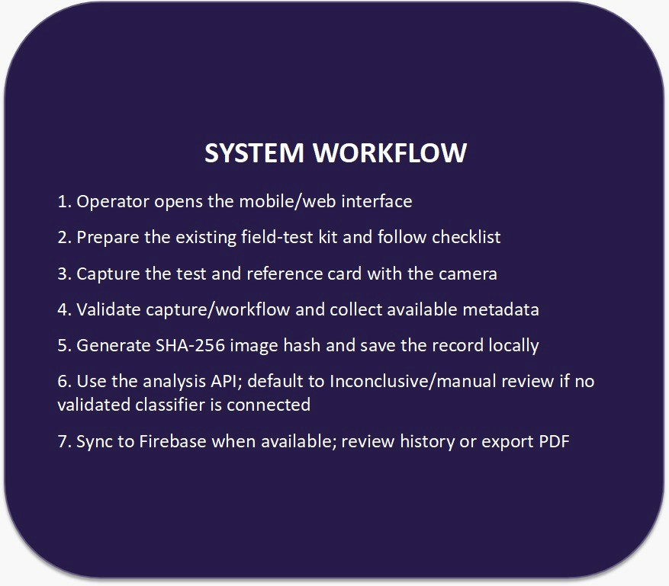
TECHNICAL APPROACH
HYPER NOVA
Prototype boundary: automated drug classification, digital signing and registered biometric credentials are not fully implemented.

Slide 4
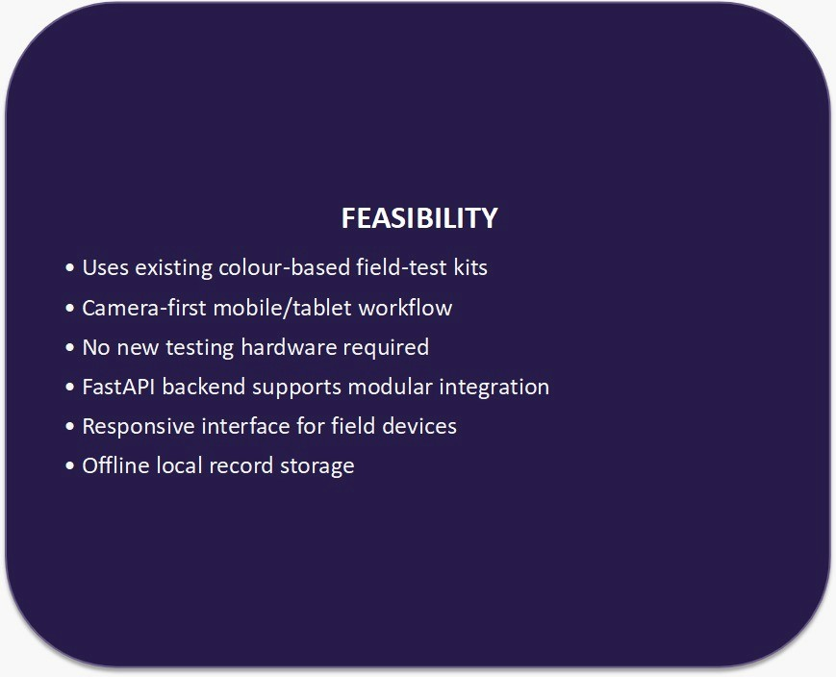
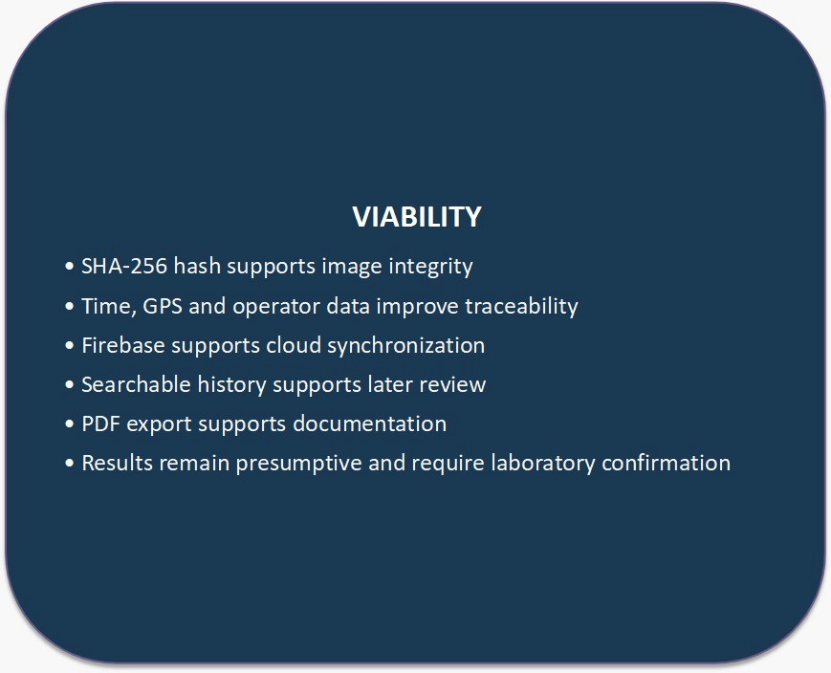
FEASIBILITY AND VIABILITY
HYPER NOVA
Feasibility
Viability

Slide 5
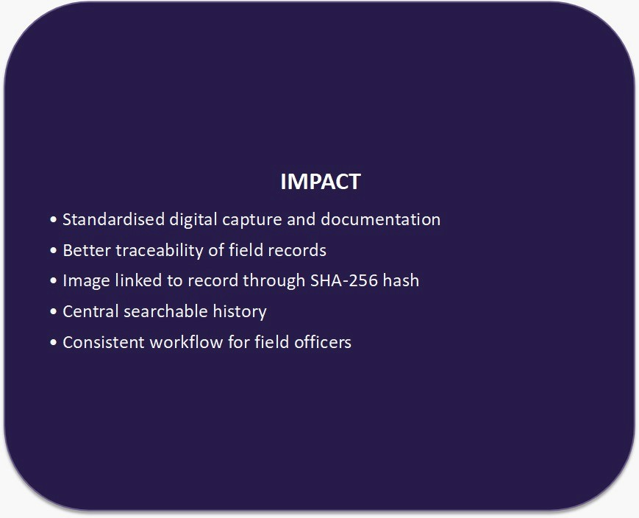
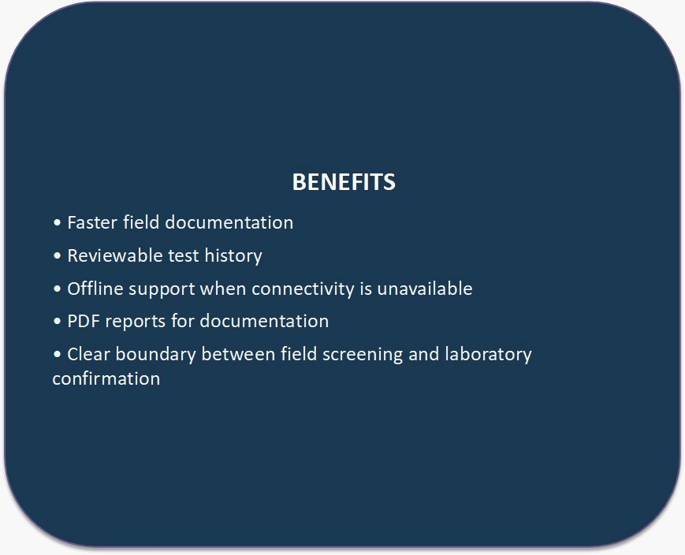
IMPACT AND BENEFITS
HYPER NOVA
Impact
Benefits

Slide 6
RESEARCH AND REFERENCES
HYPER NOVA
Smart India Hackathon 2026 — Problem Statement ID 26231: Digital Companion for Field Drug Testing
Source brief defining the field drug-testing digitisation requirement.
1
2
Ministry of Home Affairs — Narcotics Control Bureau — problem statement brief
Organization and department specified for the problem statement.
3
PS 26231 target deliverables: image capture, automated classification and a signed digital record (implementation gaps are stated on the Technical Approach slide).
Core prototype requirements specified by the challenge.
4
Participant Note in PS 26231: output is a presumptive field-test result and does not replace laboratory confirmatory testing
Explicit scope limitation stated in the challenge description.

